Slide 1
Hi Everyone, I’m Jaison Philip
An Aspiring Data Analyst

Slide 2

CONTENT
1. Company Overview
2. Business Model
3. Problem Statement
4. Dashboard Overview
5. Dashboard Explanation

Slide 3


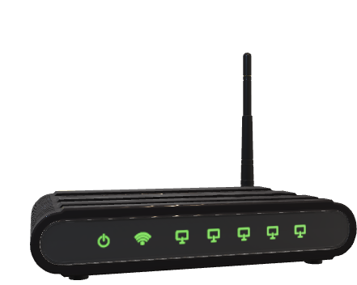
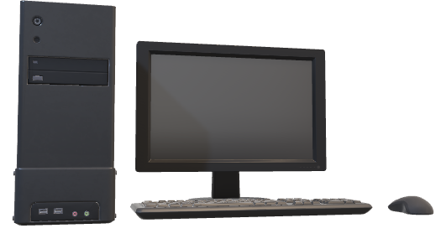
Company Overview
AtliQ Technology is a leading computer hardware brand with a strong presence across multiple countries and regions. Known for its innovative and reliable products, the company caters to a diverse range of customer needs, from individual users to large enterprises.

Slide 4
Business Model
AtliQ Technology
Retailer
Direct
Distributer
Eg: Amazon,Croma
Eg: AtliQ e Store
Eg: Neptune

Slide 5

Problem Statement
3
2
1
Previously they relied on Excel,but now they seek a more robust solution given the Company’s growth
AtliQ, a fast growing electronics company,faced setbacks in Latin America due to decisions based on just surveys and intutions
This decisions caused a significant financial loss. To enhance decision making AtliQ’s Senior executives are investing on a data analysis project

Slide 6
Dashboard Overview
Finance View
Sales View
Marketing View
Supply Chain View
Executive View

